Slide 1
Policy Improvement

Slide 2
Objectives
Generalized Policy Iteration (GPI)
Slippery Walk environment
Monte Carlo control
SARSA
On-policy and Off-policy learning
Q-Learning
Double Q-Learning
SARSA(𝜆)
Q(𝜆)
Comparison

Slide 3

Generalized Policy Iteration (GPI)
Instead of estimating the state-value function V , we estimate the action-value functions Q
to see the value of actions without having to use the MDP
After we obtain the estimation, we use it to improve the policy
like what we did in the policy-iteration algorithm of dynamic programming
evaluate, improve, then evaluate the improved policy, then improve on this improved policy, and so on…
The improvement is done by making the policy greedy with respect to the current value function
we have the action-value function estimation
no model is needed to construct the greedy policy
This pattern is called Generalized Policy Iteration (GPI)
an architecture that any reinforcement learning algorithm fits under

Slide 4

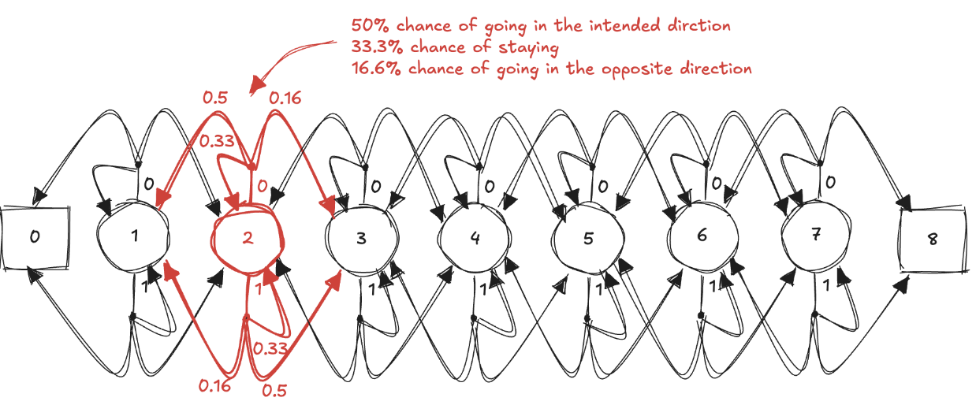
Slippery Walk environment
We use an environment called Slippery Walk
a walk in a single-row grid-world environment
seven non-terminal states
it’s slippery: action effects are stochastic
The environment is noisy, but the actions the agent selects make a difference in its performance

Slide 5
Monte Carlo control (1)
The policy improvement theorem:
assures that each 𝜋_{𝑘+1} is better than 𝜋_{𝑘}
converges to the optimal policy (and optimal value function)
First, we need to estimate 𝑄(𝑠,𝑎) instead of 𝑉(𝑠)
to know what the best action is to take from a state
we cannot use the MDP
we must estimate from samples, let’s use first-visit Monte Carlo prediction
Second, we need to explores
we can use a decaying epsilon-greedy action-selection strategy

Slide 6
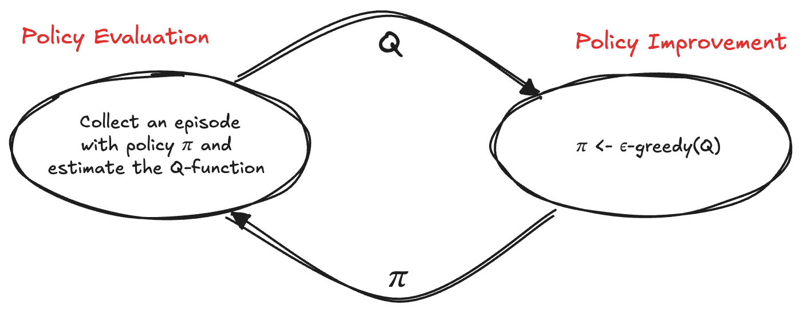
Monte Carlo control (2)
We alternate a single MC evaluation step and a single decaying epsilon-greedy action-selection improvement step

Slide 7
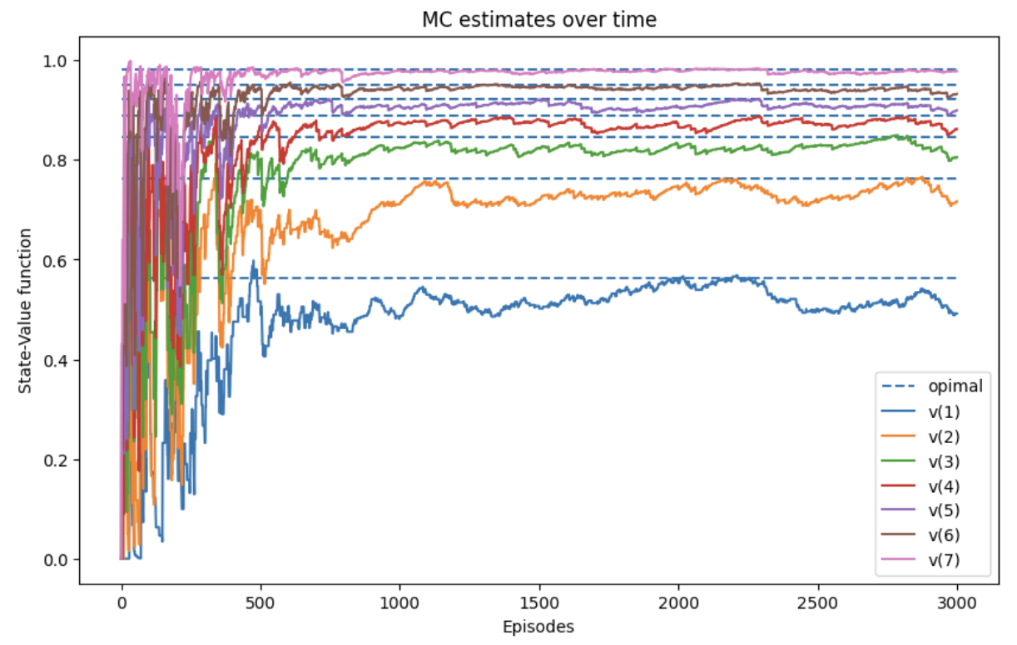
Monte Carlo control (3)

Slide 8


SARSA (1)
Monte Carlo is offline in an episode-to-episode sense
we must wait until we reach a terminal state before we can make any improvements
notice how the estimates have high variance
It’s straightforward to use temporal-difference prediction for the evaluation phase
we now have a different algorithm, the well-known SARSA agent
SARSA has less variance than MC
SARSA is slower to converge

Slide 9
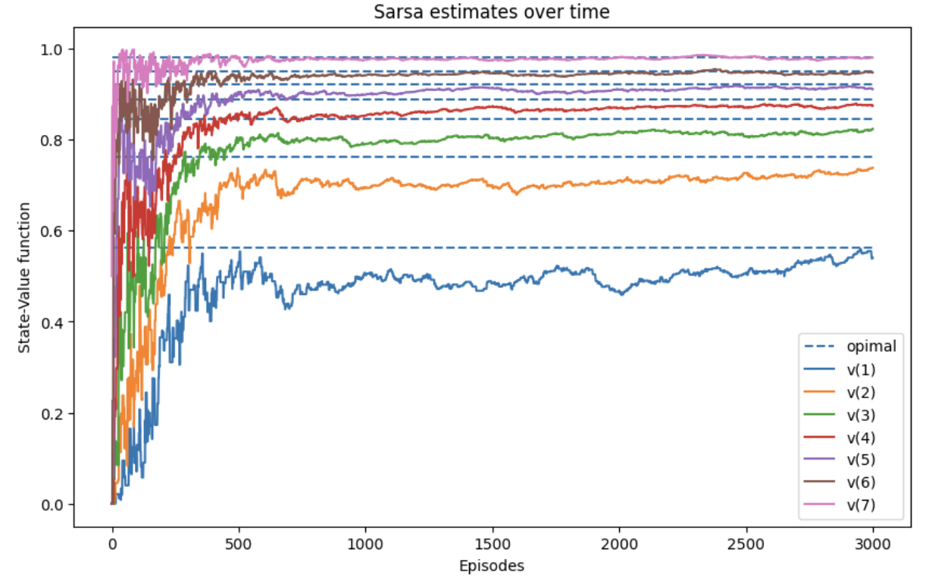
SARSA (2)

Slide 10
On-policy and Off-policy learning
In SARSA and MC agent learns the same policy used for generating experience
on-policy learning
it is excellent: we learn from our own mistakes
But we learn from our own current mistakes only
what if we want to learn from our own previous mistakes?
what if we want to learn from the mistakes of others?
Off-policy learning
sort of "learning from others”
agent learns a different policy from the one used to generate experiences
There are two policies:
behaviour policy used to generate experiences
target policy, the policy we’re learning about

Slide 11

Q-Learning (1)
Q-learning is similar to SARSA, but with a off-policy approach
We use action with the maximum estimated value in the next state, despite the action taken
Q-learning converges faster because it is not restricted by the exploration-exploitation balance of the behaviour policy
It overestimates the value function (maximization bias)
it uses maximum over estimates as an estimate of the maximum
example:
actual values are all zeros, estimates have bias (0.11, 0.65, –0.44, –0.26)
we know the maximum is zero, but the maximum over the estimates is 0.65

Slide 12
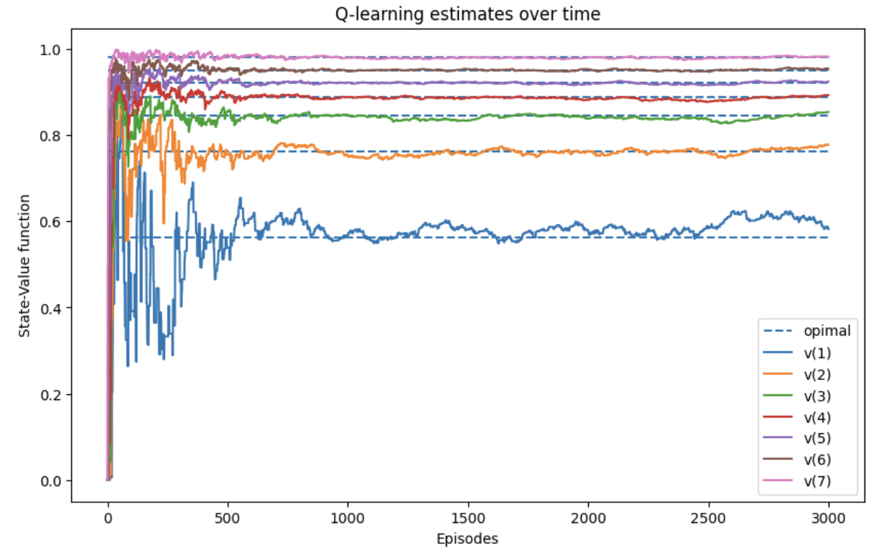
Q-Learning (2)

Slide 13
Double Q-Learning (1)
One way of dealing with maximization bias is to maintain two Q-value functions
𝑄_{𝐴} and 𝑄_{𝐵}, each one gets update from the other for the next state
the update consists of finding the action 𝑎∗ that maximises 𝑄_{𝐴} in the next state, then use 𝑎∗ to get the value of 𝑄_{𝐵}(𝑠′,𝑎∗) in order to update 𝑄_{𝐴}(𝑠,𝑎)
We can think of this similar to cross-validation:
one Q-function estimates will help us validate the other Q-function estimates
We’re splitting the experience between two functions and this slows down training
It is slower than Q-learning to get the estimates to track the optimal state-value function
but it does so in a much more stable manner
there’s still a bit of over-estimation, but it’s controlled

Slide 14
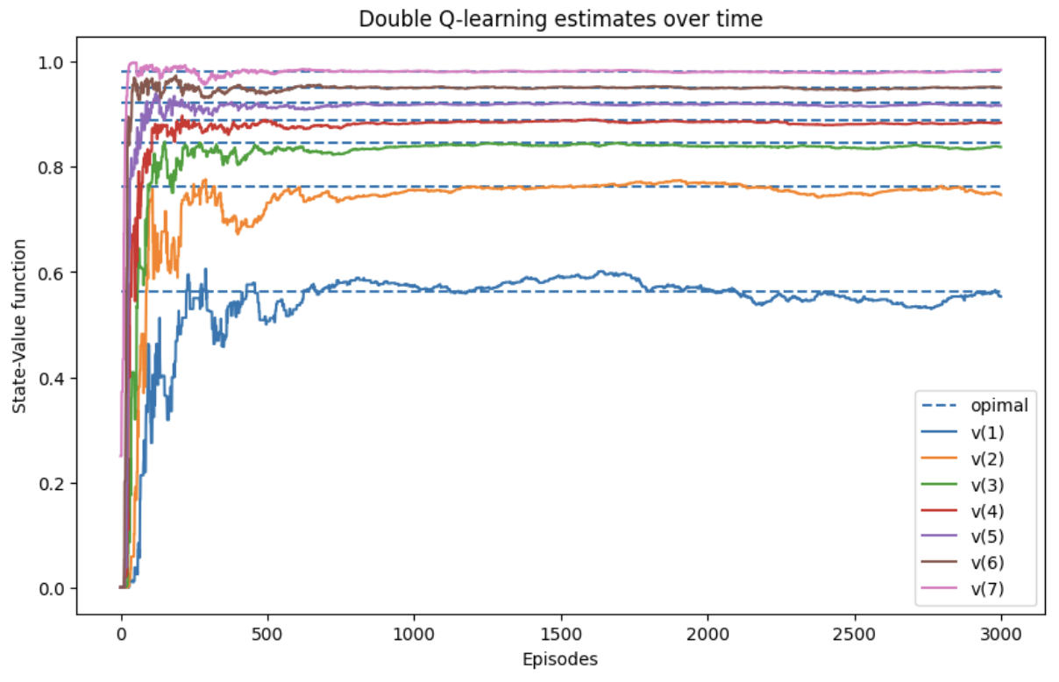
Double Q-Learning (2)

Slide 15
SARSA(𝜆) (1)
Instead of using a one-step bootstrapping target, it uses the 𝜆-return
use an eligibility matrix for tracking visited state-action pairs
when agent tries a state-action pair
the trace for this pair is incremented by one
Multiple ways of tracing state-action pairs responsible for a reward
in a loop the agent tries the same state-action pair several times
should we make this pair "more" responsible for rewards obtained?
or should we make it just responsible?
accumulating trace
allows trace values higher than one
replacing trace
clips eligibility traces to a maximum value of one
The following figure shows two strategy applied to the SWS environment

Slide 16
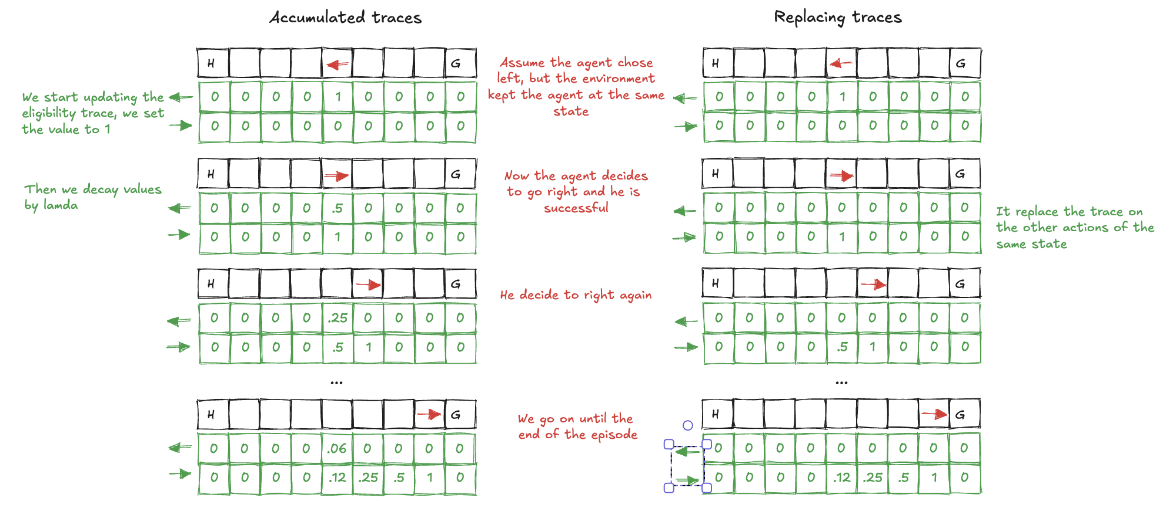
SARSA(𝜆) (2)

Slide 17
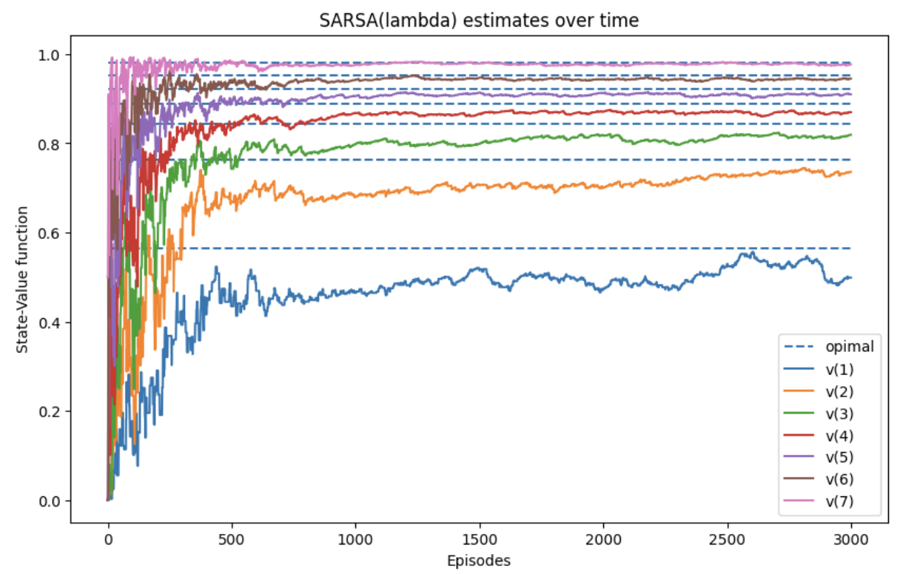
SARSA(𝜆) (3)

Slide 18
Q(𝜆) (1)
Extension of Q-learning that uses the 𝜆-return for evaluation

Slide 19
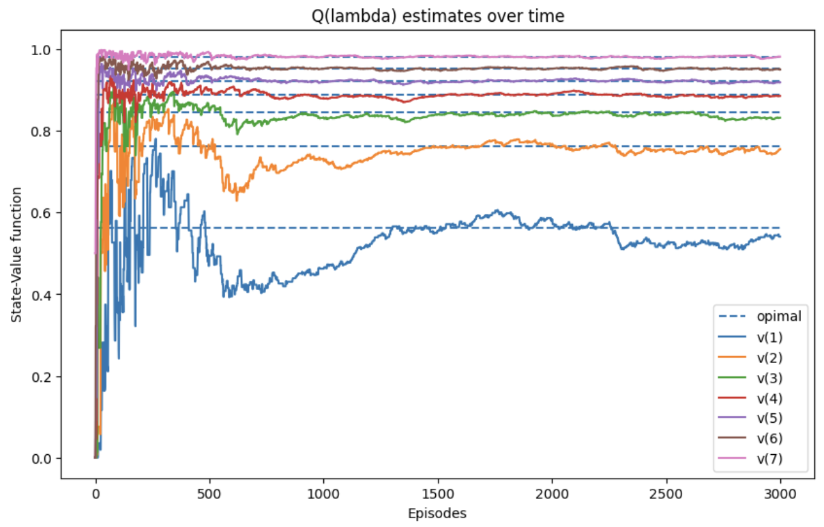
Q(𝜆) (2)

Slide 20
Comparison (1)
In the next plot, we’re looking at the state-value function estimation error
we user the mean absolute error across all estimates from their respective optimal
notice how quickly Q-learning drops near zero, but also how double Q-learning gets to the lowest error first

Slide 21
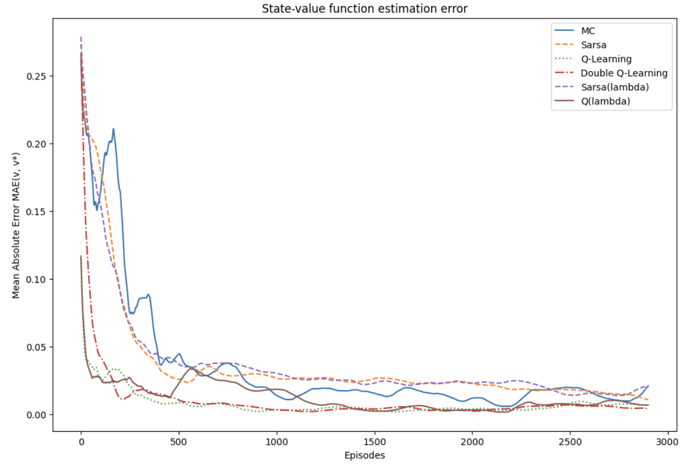
Comparison (2)

Slide 22
Comparison (3)
Monte Carlo is simple, but slow and limited to episodic tasks
Sarsa is more conservative, focusing on actions based on the current policy, and works well when stability is needed
Q-learning aggressively learns the optimal policy but is prone to overestimation
Double Q-learning is a better alternative when stability is a concern, as it mitigates overestimation
Sarsa(lambda) and Q(lambda) provide a middle ground between learning speed and robustness by using eligibility traces, with Q(lambda) being faster due to its off-policy nature
The choice of algorithm often depends on the specific environment and the need for stability, exploration, and learning speed

